Slide 1
Human resources slide 1
Davis Instruments Optimization Model
Group 7:
Ike Oyediran, Yee Ang, Chelsye Ornick, Jordyn Silvers, Truc Nguyen

Slide 2
Human resources slide 2
Agenda
Introduction
Model Set Up
Optimization Model
Hiring Strategy
Report

Slide 3
Human resources slide 2
Executive Summary
January to June Staffing Problem
Objective: Minimize total labor cost
Includes $875 training cost per hire
No contracts allowed past June
Solver found the lowest-cost plan
Optimized plan: Mixed strategy led by option 3

Slide 4

Human resources slide 3
Model Setup
Decision Variables
Number of temporary employees hired each month under:
  Option 1 (1-month)
  Option 2 (2-month)
  Option 3 (3-month)
Variables are non-negative integers
Contract Constraints
No 2-month hires in June
No 3-month hires in May or June
Ensures no contract extends beyond June
Cost Structure
Training cost: $875 per hire
Total cost per employee:
  Option 1: $2,875
  Option 2: $5,675
  Option 3: $8,375

Slide 5


Human resources slide 5
Optimization Model
Objective Function
Minimize Total Cost
Z = Cost of option 1 hires + Cost of option 2 hires + Cost of option 3 hires
Monthly Demand Requirements
Jan: >= 10
Feb: >= 23
Mar: >= 19
Apr: >= 26
May: >= 20
Jun: >= 14
Key idea
Workers remain active based on contract length
Total available workers each month must meet demand

Slide 6
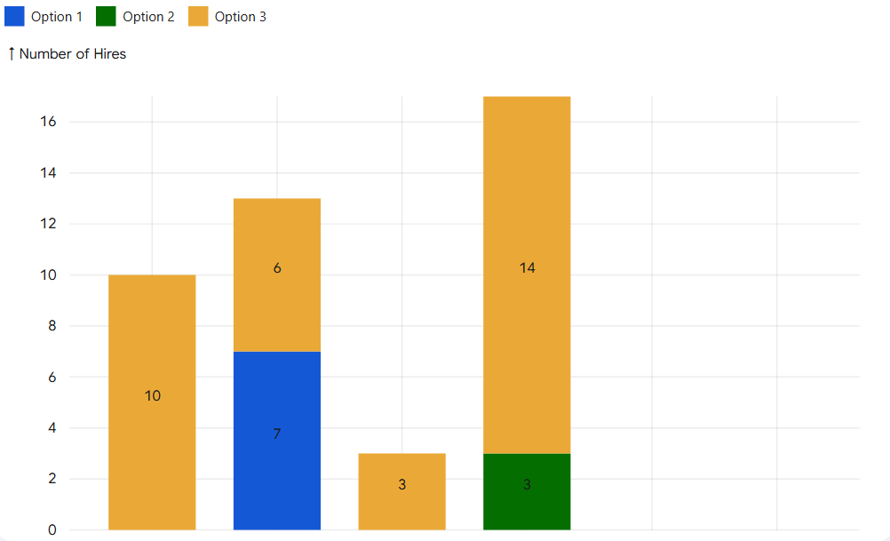
Human resources slide 5
Hiring Strategy
April
Total Hires: 43
Total Minimized Cost: $313,525
February
Number of Hires
January
March
New Hires by Month & Contract Type
Notes:
On thie slide I will be explaining our hiring strategy under which we will hire each month for each contract type. I used excel solver To visualize the optimization model. Option 1,2, and 3 contracts differ in amount with option 1 being the most affordable and option 3 being the least. However hiring more under option 3 actually provides the most optimal solution and produces the most efficient cost and use of resources. The strategy maximizes Option 3 contracts for 33 out of 43 total hires (Jan, Feb, and April) because they offer the lowest monthly rate of ($2,791.67/mo) since it is only spread between 3 months as opposed to a monthly rate of $2875 per month using the 1 month contract. So the strategy only uses Option 2 and Option 1 only as "bridge" hires to fill precise gaps in January, February, and May.
Option 3: $8,375
The total cost $313,525 represent the absolute minimum amount of money Davis instruments must spend on temporary labor without ever being short-staffed. Included in the cost is the base pay for the duration of each contract as well as the training fee at a fixed cost of $875. if we follow this exact hiring schedule, we will meet all our production needs and respect the June merger deadline

Slide 7

Report
Hiring Strategy
The optimal solution is a mixed hiring strategy dominated by Option 3.
Strategy Balance
Cost – lowest costing, most cost-efficient, more value.
Workforce Stability – lower turnover rates, less disruption in workflow and workspace, reliable and stable.
Solution Sensitivity
Flexibility – demand increase and decrease
Financing – worker gap accommodations

Slide 8

Report (Continued)
The Training Cost Impact
The $875 Fixed Fee – The $875 training fee is a flat rate regardless of tenure, which is why the model leans on Option 3 as the main cost-saver while using Options 1 and 2 as "gap fillers" to handle monthly spikes in demand.
Cost vs Flexibility – Spreading fees over 3 months creates efficiency but locks in the schedule
Business Risks & Budget Uncertainty
"Dead Weight" Labor – Contracts cannot be broken so lower demand forces payment for idle staff
Emergency Spikes – Unexpected needs may require added short-term hires at a higher effective monthly cost
Proposed Model Enhancements
Training Capacity – Needs a physical limit on monthly trainees to protect the actual quality control staff
Employee Retention – Keeping people longer helps manage the learning curve and prevents mistakes
Quality over Price – Goal should be getting the work done right instead of just the lowest cost

Slide 9
Human resources slide 10
Thank you for listening!

